Slide 1
Title: Water Quality Prediction
UMBC Data Science Master Degree Capstone
Dr. Chaojie (Jay) Wang
Author Name: Manish Bhima
ZO20612

Slide 2
Introduction
An effective health protection policy must include access to safe drinking water, which is also a fundamental human right. From a national, regional, and local perspective, this is a critical issue for development and health. Studies in certain areas have demonstrated that funds allocated to improving sanitation and water availability can result in a positive economic impact, as the decreases in health-related expenses and unfavorable health outcomes surpass the expenses incurred in implementing these measures.
An effective health protection policy must include access to safe drinking water, which is also a fundamental human right. From a national, regional, and local perspective, this is a critical issue for development and health. Studies in certain areas have demonstrated that funds allocated to improving sanitation and water availability can result in a positive economic impact, as the decreases in health-related expenses and unfavorable health outcomes surpass the expenses incurred in implementing these measures.
An effective health protection policy must include access to safe drinking water, which is also a fundamental human right. From a national, regional, and local perspective, this is a critical issue for development and health. Studies in certain areas have demonstrated that funds allocated to improving sanitation and water availability can result in a positive economic impact, as the decreases in health-related expenses and unfavorable health outcomes surpass the expenses incurred in implementing these measures.

Slide 3
Dataset Overview
1. ph: pH of water (0 to 14).
2. Hardness: Capacity of water to precipitate soap in mg/L.
3. Solids: Total dissolved solids in ppm.
4. Chloramines: Amount of Chloramines in ppm.
5. Sulfate: Amount of Sulfates dissolved in mg/L.
6. Conductivity: Electrical conductivity of water in μS/cm.
7. Organic_carbon: Amount of organic carbon in ppm.
8. Trihalomethanes: Amount of Trihalomethanes in μg/L.
9. Turbidity: Measure of light emiting property of water in NTU.
10. Potability: Indicates if water is safe for human consumption. Potable -1 and Not potable -0

Slide 4
About the data
Data Sources: Water Quality
Data Size:
The dataset consists of 10 variables/columns and 3276 rows.

Slide 5
Target variable
The target variable is the ‘Potability’ column. This variable represents whether the water given is suitable for drinking or not. ‘1’ indicates suitable for drinking where as ‘0’ indicates not suitable
Features/ Predictors
'pH', ‘Hardness', ‘Solids’, ‘Chloramines', ‘Sulfate', ‘Conductivity ‘, ‘Trihalomethanes', and ‘Turbidity' can be used as variables for predicting machine learning models. These variables represent categorical features, and depending on the nature of your predictive task, they can be valuable predictors for your model.

Slide 6
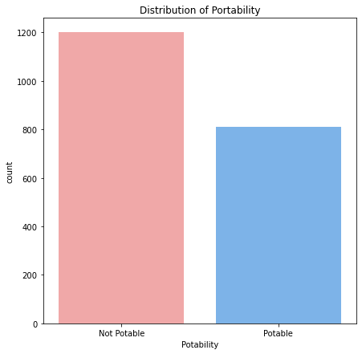
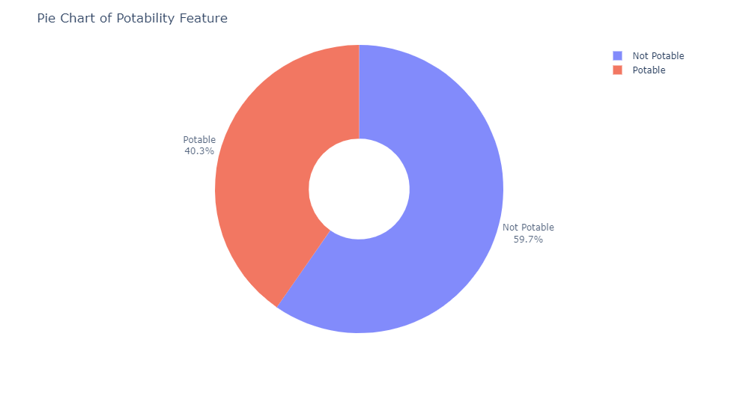
Exploratory Data Analysis

Slide 7
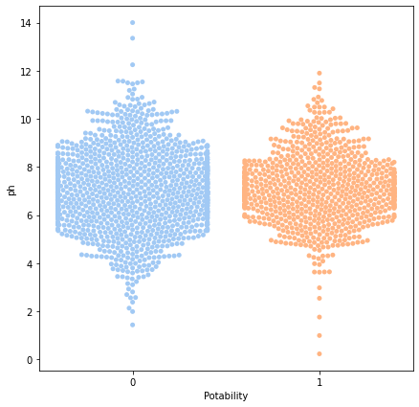
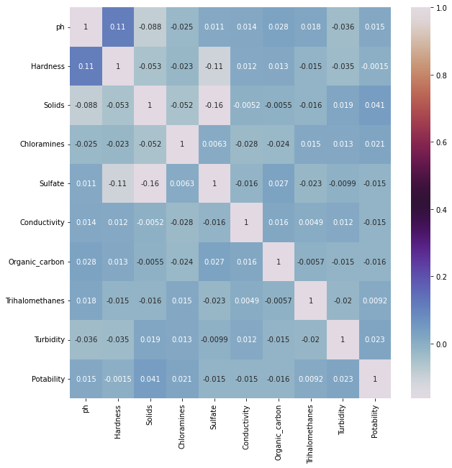
Distribution of Potability of water with ph values

Slide 8
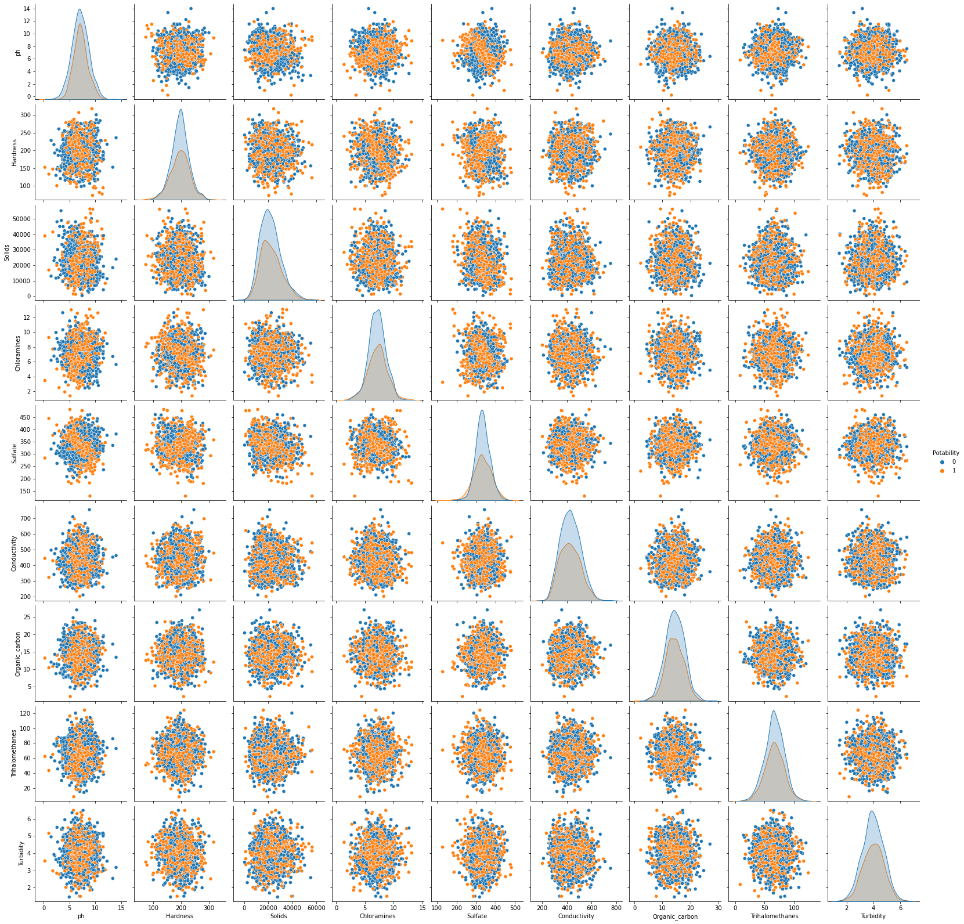

Slide 9
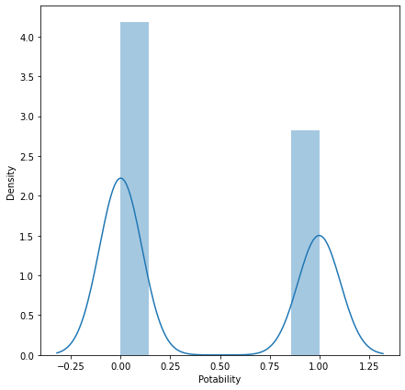
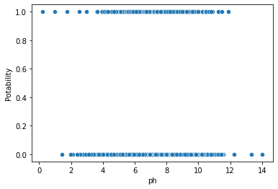

Slide 10
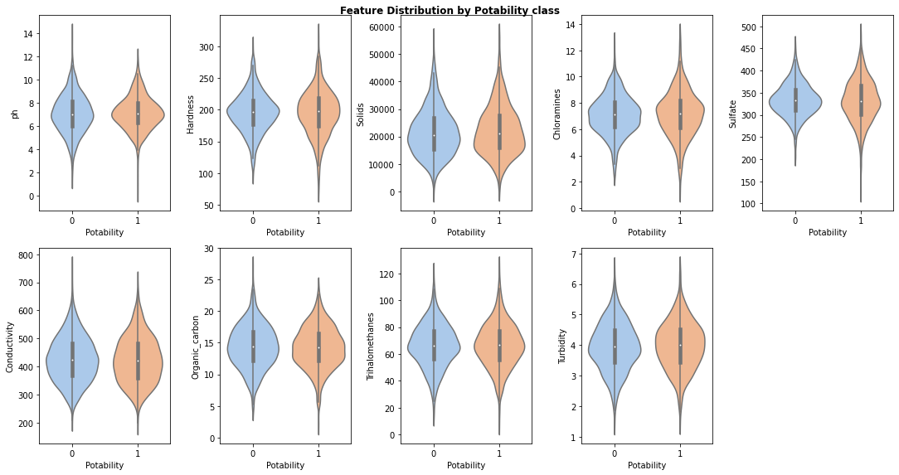

Slide 11
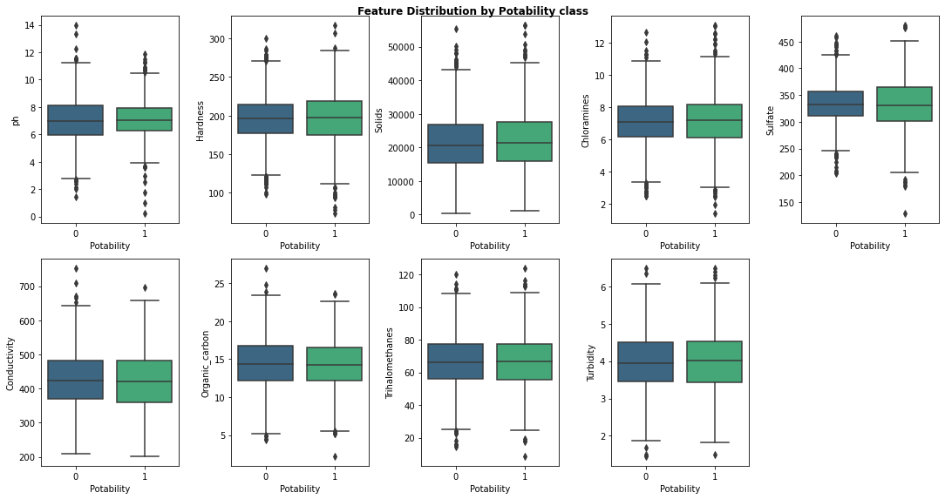

Slide 12
Machine learning predictions
In this project, machine learning techniques are applied to analyze and predict quality of water based on various factors.
By leveraging machine learning algorithms, we can build predictive models that estimate health insurance charges based on factors such as pH,sulfates , hardness, trihalomethanes, turbides, chloramines and solids.
These predictive models can help us in prerdicting whether the given water is potable for drinking or not.

Slide 13
Classification models used in this project are:
Random Forest Classifier
Support Vector Classifier
XGB Classifier
Preprocessing
Data preprocessing is a critical step in machine learning workflows to ensure data compatibility with models.
Standardization and encoding techniques are applied to handle numerical and categorical features, respectively.
This step ensures that the data is in a suitable format for model training.

Slide 14
Model Evaluation
Splitting the dataset into training and testing sets using train_test_split.
Fitting the model on the training data using the fit method.
Making predictions on the testing data using the predict method.

Slide 15
Model building with Random Forest Classifier
Random Forest Classifier is an ensemble learning method used for classification tasks in machine learning. It constructs multiple decision trees during training and outputs the class that is the mode of the classes (classification) or mean prediction (regression) of the individual trees.
Random Forest is effective because it reduces overfitting by averaging the predictions of multiple trees and utilizes the wisdom of crowds to make robust predictions. After splitting the dataset in training and testing for accuracy, the value is
individual trees.
Accuracy – 70%

Slide 16
Model building with XGBCLASSIFIER
XGBoost, short for Extreme Gradient Boosting, is a powerful machine learning algorithm that belongs to the boosting family. It combines the advantages of both bagging and boosting techniques, utilizing an ensemble of weak learners (decision trees) to create a strong learner
XGBoost's versatility, scalability, and effectiveness make it a go-to choice for many data scientists and machine learning practitioners.
Accuracy- 67%

Slide 17
Model building with SVC
SVC stands for Support Vector Classifier, which is a type of support vector machine (SVM) used for classification tasks. It aims to find the hyperplane that best separates data points into different classes. Unlike other SVM variants like Support Vector Regression (SVR), which is used for regression tasks, SVC focuses specifically on classification.
SVC's ability to handle complex classification problems efficiently while maintaining high performance makes it a significant choice in various machine learning applications.
Accuracy- 71%
Because of the highest accuracy of 71% we choose SVC as the preferred choice of classifier for training the model.

Slide 18
Web Application
Flask web application utilizes a pre-trained machine learning model to predict the water potability based on user input.
Users input the pH, hardness , solids, chloramines,sulfate, conductivity, organic carbon, trihalomethanes, turbidity values through a simple web form. This data is then transmitted to a pre-trained machine learning model, which utilizes water quality data to make predictions.
The model predicts water potablity based on the information provided.

Slide 19
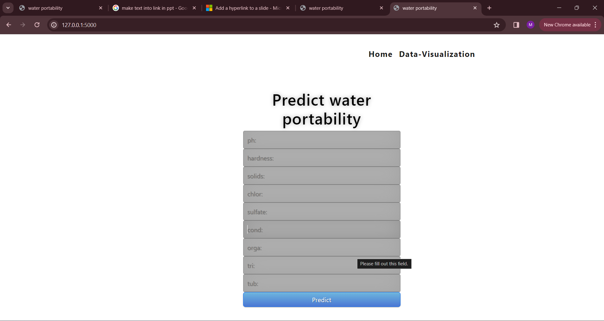
Web Application

Slide 20
Conclusion
My analysis involved robust data preprocessing and model building, utilizing Random Forest Classifier, XGBoost Classifier, and Support Vector Classifier.
The developed models demonstrated strong predictive performance in estimating water potability, with the SVC Model exhibiting exceptional accuracy.
Implications- Water quality prediction projects play a crucial role in safeguarding public health, preserving the environment, optimizing resource utilization, shaping policies, and fostering community participation in water management.
In conclusion, water potability prediction projects play a significant role in ensuring access to safe drinking water by leveraging advanced technologies to forecast water quality accurately. By integrating machine learning algorithms with water quality data, these projects contribute to public health initiatives and aid in decision-making processes related to water management and treatment.

Slide 21
Thank you

